Slide 1
L E C T U R E
2
SOFTWARE PROCESS
Notes:
This repository of slides is intended to support the named chapter. The slide repository should be used as follows:
Copy the file to a unique name for your course and unit.
Edit the file by deleting those slides you don’t want to cover, editing other slides as appropriate to your course, and adding slides as desired.
Print the slides to produce transparency masters or print directly to film or present the slides using a computer image projector.
Each slide includes instructor notes. To view those notes in PowerPoint, click-left on the View Menu; then click left on Notes View sub-menu. You may need to scroll down to see the instructor notes.
The instructor notes are also available in hardcopy as the Instructor Guide to Accompany Systems Analysis and Design Methods, 5/ed.

Slide 2
Objective of Today's lecture
Will learn about the PROCESS that is to be a road map and predictable steps which helps you to create timely and high-quality result.
That road map that you follow is called a software process.
It done by software engineers and it is important because it provides stability, control, and organization to an activity that can, if the left uncontrolled, become quite chaotic

Slide 3
OVERVIEW OF THE SOFTWARE PROCESS.
The roadmap to building high quality software products is software process.
Software processes are adapted to meet the needs of software engineers and managers as they undertake the development of a software product.
A software process provides a framework for managing activities that can very easily get out of control.
Different projects require different software processes.
The software engineer's work products (programs, documentation, data) are produced as consequences of the activities defined by the software process.
The best indicators of how well a software process has worked are the quality, timeliness, and long-term viability of the resulting software product.

Slide 4
How do we define software engineering?
SOFT WARE ENGINEERING:
The application of is a systematic, disciplined , quantifiable approach to the development , operation, and maintenance of software; that is the application of engineering to software.

Slide 5
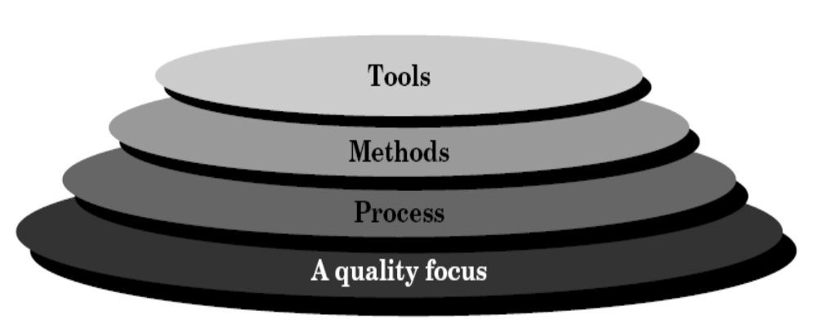
Software engineering layers

Slide 6
Generic Software Engineering Phases
Definition phase - focuses on what (information engineering, software project planning, requirements analysis).
Development phase - focuses on how (software design, code generation, software testing).
Support phase - focuses on change (corrective maintenance, adaptive maintenance, perfective maintenance, preventative maintenance).

Slide 7
Software Engineering Umbrella Activities
Software project tracking and control
Formal technical reviews
Software quality assurance
Software configuration management
Document preparation and production
Reusability management
Measurement
Risk management

Slide 8
Figure: The software process
Common process framework
Framework activities
Task sets
Task
Milestone, deliverable
SQA points
Umbrella activities

Slide 9
Common Process Framework
Software engineering work tasks
Project milestones
Work products
Quality assurance points

Slide 10
Software Engineering Institute (SEI) Capability Maturity Model (CMM)
Level 1: Initial (ad hoc software processes)
Level 2: Repeatable (able to repeat earlier successes)
Level 3: Defined (management and engineering processes documented, standardized, and integrated into organization-wide software process)
Level 4: Managed (software process and products are quantitatively understood and controlled using detailed measures)
Level 5: Optimizing (continuous process improvement is enabled by quantitative feedback from the process and testing innovative ideas)

Slide 11
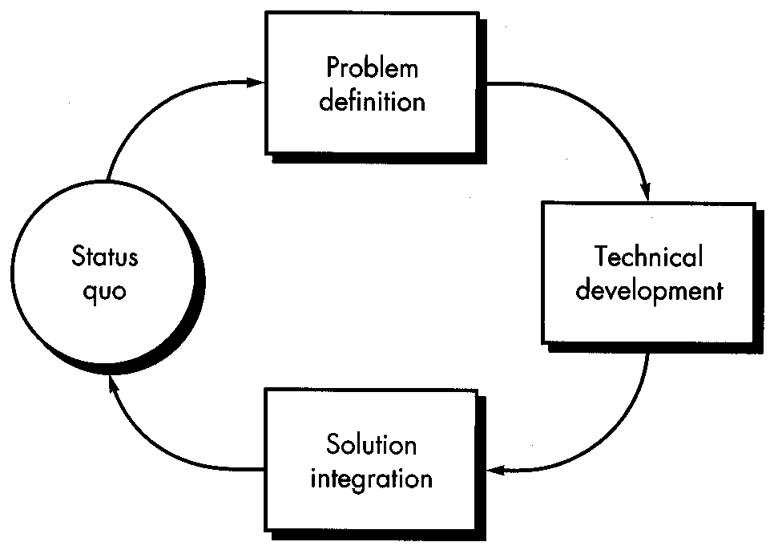
Software Process Models
The Basic Process Loop

Slide 12
Linear Sequential Model
Steps:
  System engineering
  Requirements analysis
  Design
  Code generation
  Testing
  Maintenance
Linear Sequential Model (old fashioned but reasonable approach when requirements are well understood)

Slide 13
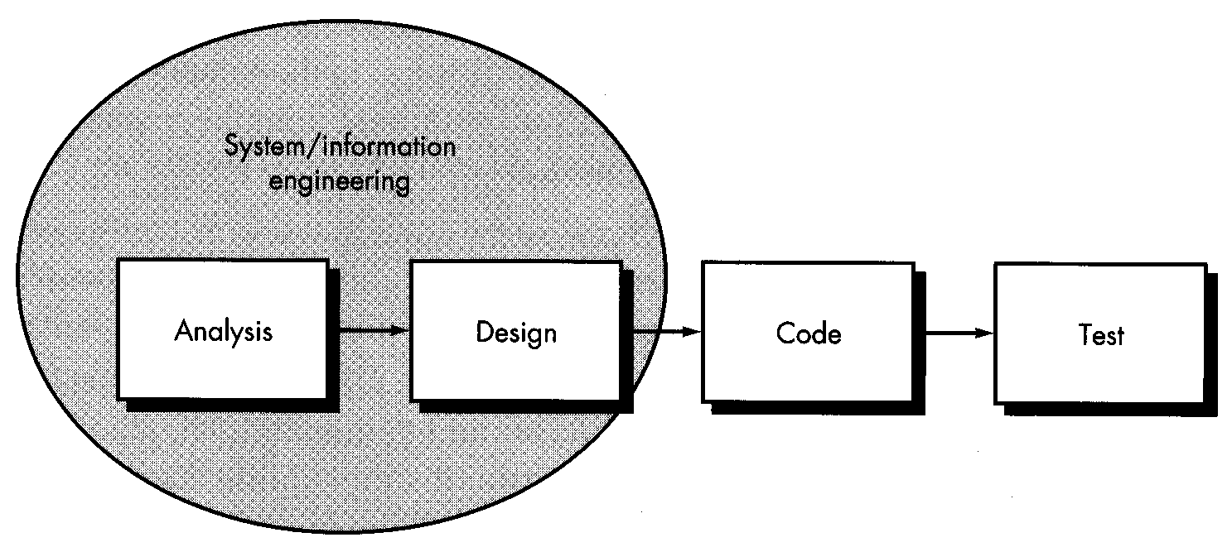
Linear Sequential Model

Slide 14
Linear Sequential Model
Challenges/Why does the linear model sometimes fail?:
  Real projects rarely follow sequential flow (changes can cause confusion)
  Difficult for customer to state requirements explicitly
  Customer must have patience
  Developers sometimes delayed unnecessarily (‘blocking states’)

Slide 15
Prototyping Model
Steps:
  Listen to customer
  Build prototype
  Customer “test drives” prototype
Challenges:
  “Throw-away” phenomenon
  Demos can set unrealistic expectations
  Compromises that solidify
Prototyping Model (good first step when customer has a legitimate need, but is clueless about the details, developer needs to resist pressure to extend a rough prototype into a production product)

Slide 16
